Slide 1
Face Entropy
By: Roy Zohar and Roy Mezan

Slide 2
Formalities
Roy Zohar - 209896174
Roy Mezan - 319042800
Instructors:
Prof. Rita Osdachy
Dr. Orr Dunkelman

Slide 3
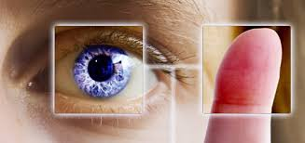
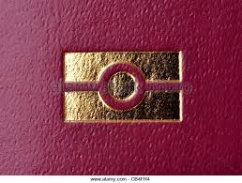
Today
The world is moving to biometric authentication methods:
Efficient
Easy
Fairly accurate

Slide 4
Problems
Unchangable - Passwords can be changed
Reprucussions - השלכות כשמאבדים סיסמא
Leaving traces (fingerprints, photos…)

Slide 5
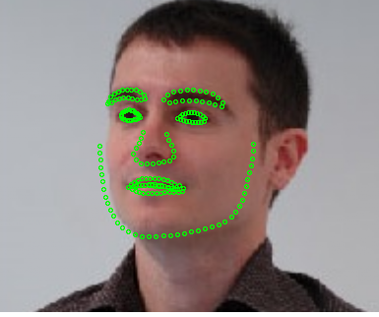
State of the art - Dlib

Slide 6
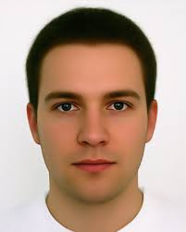
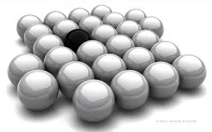
Biometric System
Image
Crypto
Good?
DLIB
Deep
Learning
Representation

Slide 7
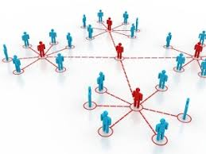
What we are going to do
Our goal is to prove that in reality, the state of the art facial recognition has a very low entropy, which makes it vulnerable to brute force attacks.

Slide 8
What we are going to do
Image
Crypto
Good?
DLIB
Deep
Learning
Representation

Slide 9
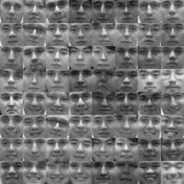
What we are going to do
Face space
Representation
Representation
Representation
M

Slide 10
Schedule
Oct - Nov
Nov-Jan
Jan - Mar
Mar - May
Defining all of our data sources
Playing around with Dlib and creating faces
Running hamming distance from a group of faces
Results and finding enthropy
Dlib libraries, Face distributuions, Cloud computing, Data Servers.
Learning how to create faces based on output of dlib
Run using cloud computing to find the size of the face space
Concluding the results

Slide 11

Thanks for listening!
Questions?

